Slide 1
Переведите слова на русский язык
8. a T-shirt
9. a uniform
10. shoes
11. a coat
12. a skirt
13. jeans
a dress
a sweater
a blouse
a hat
shorts
trousers
boots

Slide 2

Год делится на четыре сезона – зима, весна, лето, осень
4
ЗИМА
ВЕСНА
ЛЕТО
ОСЕНЬ

Slide 3
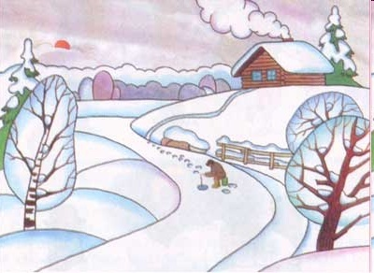
WINTER

Slide 4
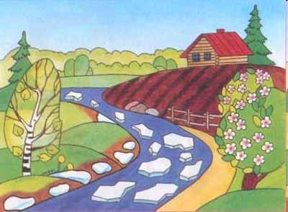
SPRING

Slide 5
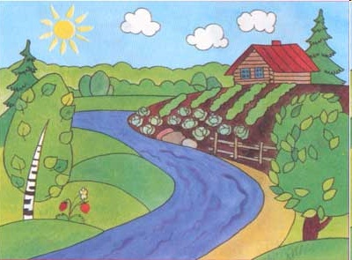
SUMMER

Slide 6
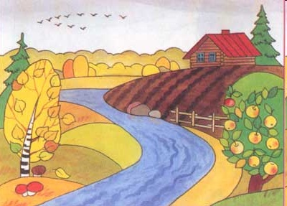
AUTUMN

Slide 7
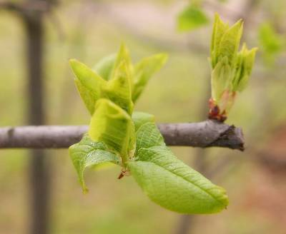
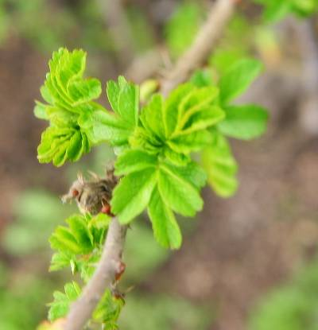
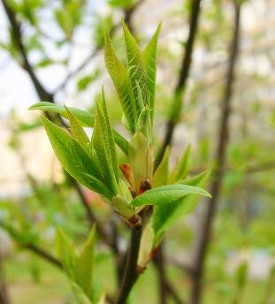
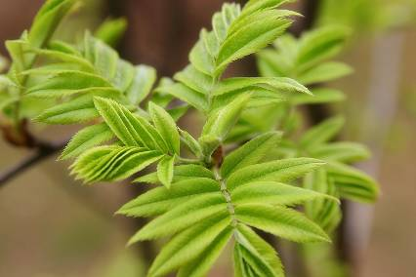
SPRING IS GREEN

Slide 8
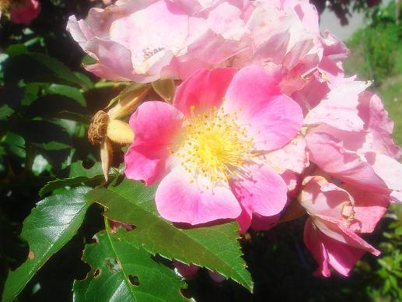
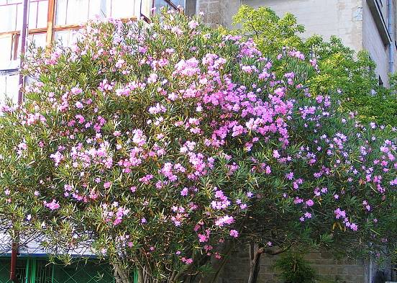
SUMMER IS BRIGHT

Slide 9
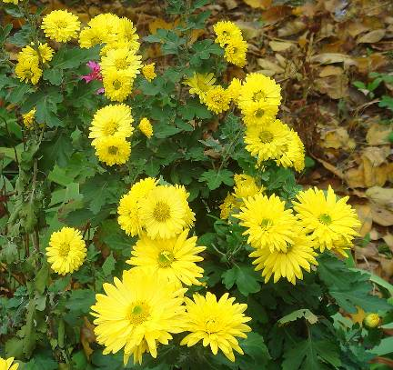
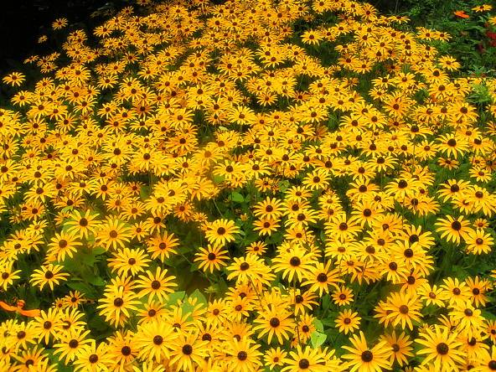
AUTUMN IS YELLOW

Slide 10
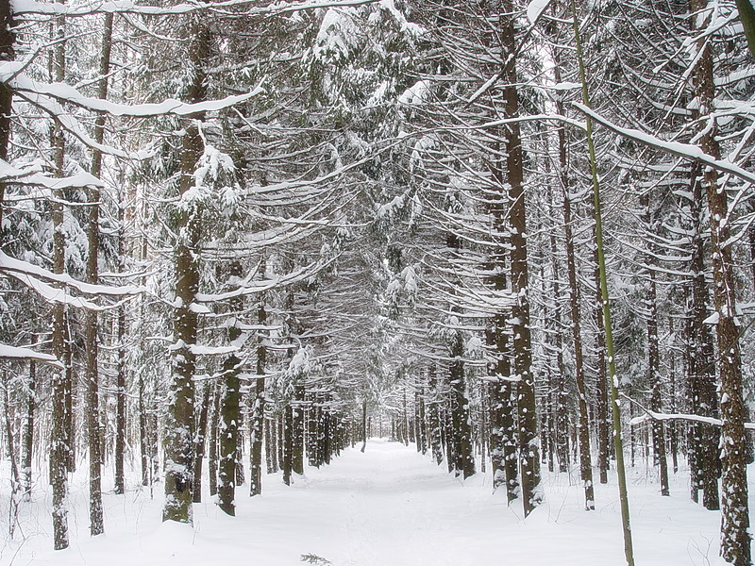
WINTER IS WHITE

Slide 11
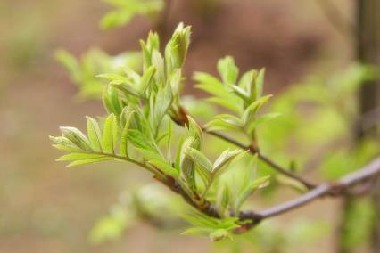
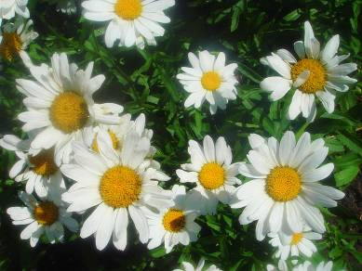
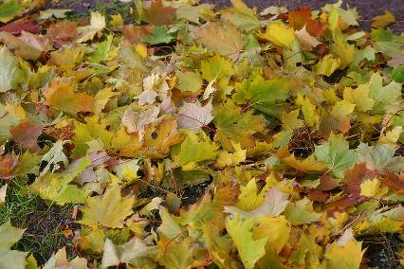
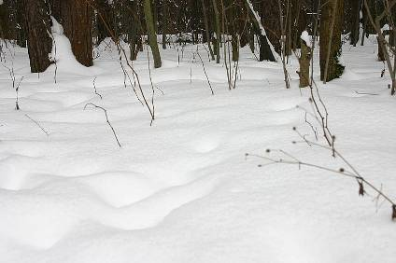
Spring is green
Summer is bright
Autumn is yellow
Winter is white

Slide 12
Winter months are…
December
January
February

Slide 13
Spring months are…
MARCH
APRIL
MAY

Slide 14
Summer months are…
June
July
August

Slide 15
Autumn months are…
September
October
November

Slide 16
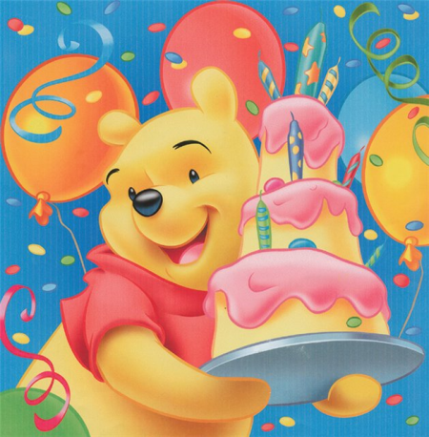

When were you born?
I was born in …

Slide 17


What is the title of the lesson?

Slide 18


What colour is Spring ? (Summer, Winter,
Autumn)

Slide 19
What are Spring months?
Spring months are….

